Slide 1
SEQUENCE DIAGRAM / INTERACTION DIAGRAM

Slide 2
SEQUENCE DIAGRAM
Captures dynamic behavior (time-oriented)
Purpose
  Model flow of control
  Illustrate typical scenarios
A sequence diagram shows
  an interaction arranged in time sequence,
  the objects (not classes)
  and the messages that pass between them when an interaction occurs

Slide 3
OBJECTS are shown in rectangles on the top of the diagrams, Each rectangle contains
Name (always underlined) [objects are underlined not class]
MESSAGES appear as arrows with a text description
objectName:className
getID()
A narrow vertical line called the ACTIVATION represents the period of time an object is actually performing an action
  Directly
  Or through an intermediary (such as another object)
Below each object rectangle, shown with a dotted line, is the LIFELINE, of that object.
A time-ordered visual framework for message exchange between the objects (and with the system)

Slide 4
MESSAGE TYPES
1. Simple Message
  Control is passed from one object to another without providing details
:Sale
Msg()
2. Self Message
A message being sent from an object to itself
:Sale
Msg()

Slide 5
3. Conditional Message
A condition can be expressed with this message
:Sale
[color=red] calculate()
4. Mutually exclusive conditional messages
  Notation for this kind of message is an angled line emerging from a common point
:Sale
:Product
:Item
[x>10] calculate()
[x<10] calculate()

Slide 6
5. Object destruction message
A message with <<destroy>> stereotype and a short lifeline indicates an explicit object destruction
:Sale
<<destroy>>
:Sale
:Product
6. Return Message
  This message indicates a return from a procedure call
Msg()

Slide 7
SEQUENCE DIAGRAM: EXAMPLE
:Caller
:Operator
:Callee
call
ack
number
time
call
ack
transfer
talk

Slide 8
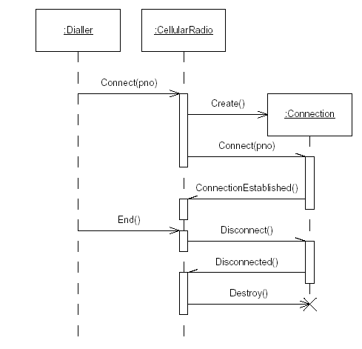

Slide 9
COLLABORATION DIAGRAM
A Collaboration Diagram also shows the passing of messages between objects BUT focuses on the order of objects and their messages instead of the time sequence
  Basic Notations
    Objects
    Links
    Messages
  Basic Steps
    Identify roles involved
    Identify interactions & concurrent threads
    Sequentially number them and mark with arrows for directions

Slide 10
COLLABORATION DIAGRAM
1: Picks Up
3: Dial Number
7: Converse
8: Hangs Up
:callSystem
2: Dial Tone
: Caller
5: picks up
4: Ring
6: Converse
: Receiver

Slide 11
ELEVATOR PROBLEM

Slide 12
PROBLEM STATEMENT
A product is to be installed to control n elevators in a building within m floors. The problem concerns the logic required to move elevators between floors according to the following constraints
Each floor , except the first floor and the top floor, has two buttons, one to request an up elevator and one to request a down elevator. These illuminates when pressed. The illumination is cancelled when an elevator visits the floor and then moves in the desired direction
Each elevator has a set of m buttons, one for each floor. These illuminates when pressed and cause the elevator to visit the corresponding floor. The illumination is cancelled when corresponding floor is visited by the elevator
There is a display window that shows the current floor being visited by the elevator
When an elevator has no request, it remains at its current floor with its door closed

Slide 13
IDENTIFY ACTOR, GOALS, USE CASES
Elevator
Goals
He get authentication and pass the security system
He visits the elevator and wants to move to the destination floor without interruption
Get authenticate
Start elevator
Visitor
Visit Floor

Slide 14
<<UC-1>>START ELEVATOR SSD
Scenario
Visitor A presses the Up floor button at floor 3 to request an elevator, he wishes to go to floor 7
The up floor button turned on
An elevator arrives at floor 3
The up floor button turn off
The elevator doors open
The timer starts
Visitor A enters the elevator
The elevators door close after the time out
ElevatorSystem:
:Visitor
UpFloorRequest(FloorNo)
ArrivalBeepSound()
CloseDoorBeep()

Slide 15
PARTIAL DOMAIN MODEL: ELEVATOR PROBLEM
Visitor
Floor
n
*
enters
1
visits
ElevatorDoor
Elevator
1
controls
controls
n
m
FloorButton
ElevatorButton
Illuminate: Boolean
Illuminate: Boolean

Slide 16
<<UC-1>>START ELEVATOR SEQUENCE DIAGRAM
:ElevatorButton
:Elevator
:ElevatorDoor
:Visitor
UpFloorRequest()
UpFloorRequest(FloorNo)
TurnButtonOn()
MoveFloor()
TurnButtonOff()
OpenDoor()
acknowledgement
StartTimer()
CloseDoor()

Slide 17
<<UC-1>>Start Elevator Collaboration Diagram
:ElevatorButton
:ElevatorDoor
3: Turn Button On
5: Turn Button Off
2: UpFloorRequest
6: Open Door
1: UpFloorRequest
8: Close Door
7: Ack
:Elevator
4: Move to Required Floor
:Visitor

Slide 18
REFERENCES
Applying UML and Patterns by Craig Larman
  Chapter 13: 13.1, 13.2, 13,9
  Chapter 15: 15.1, 15.5, 15.6, 15.7
Other Reference
  Object-Oriented and Classical Software Engineering by Stephen. R. Schach
Site Reference
  http://www.agilemodeling.com/artifacts/sequenceDiagram.htm

